Slide 1

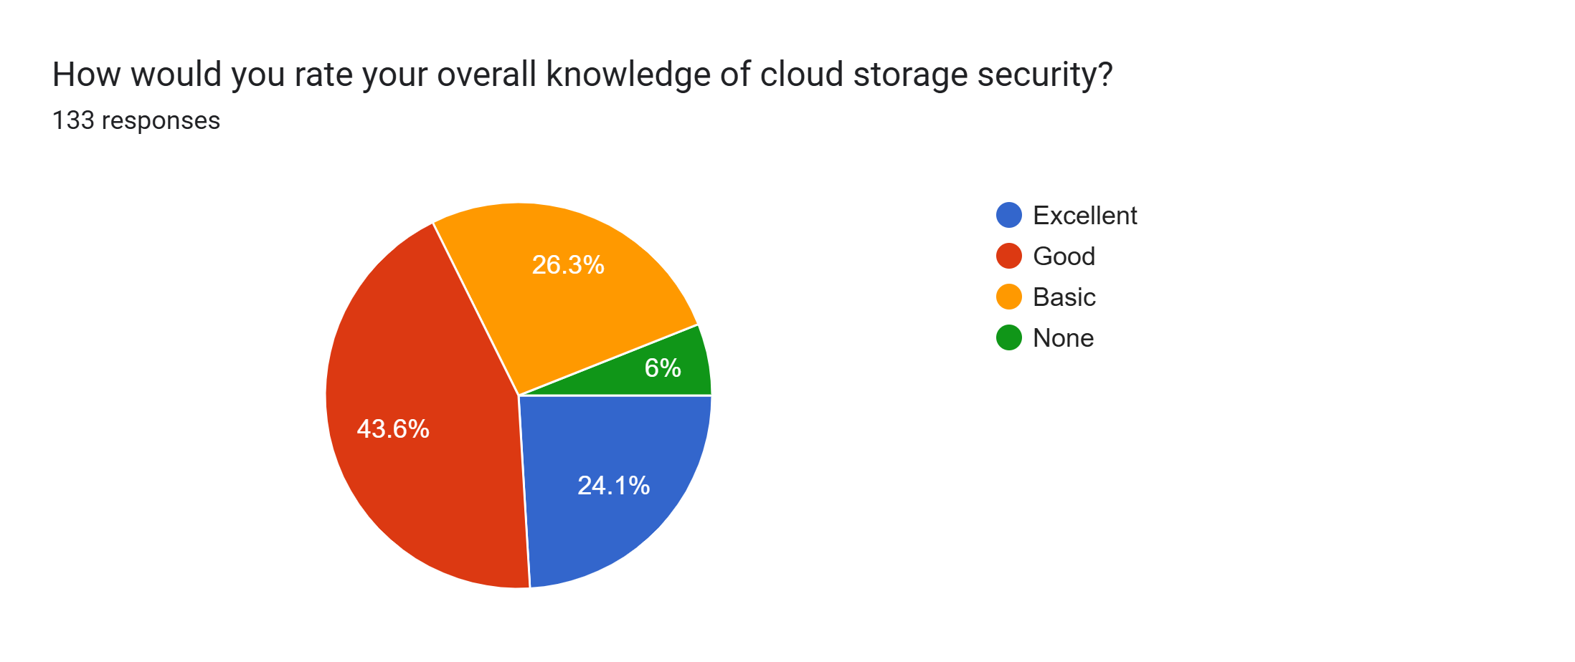
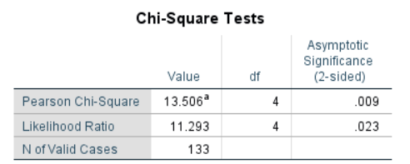
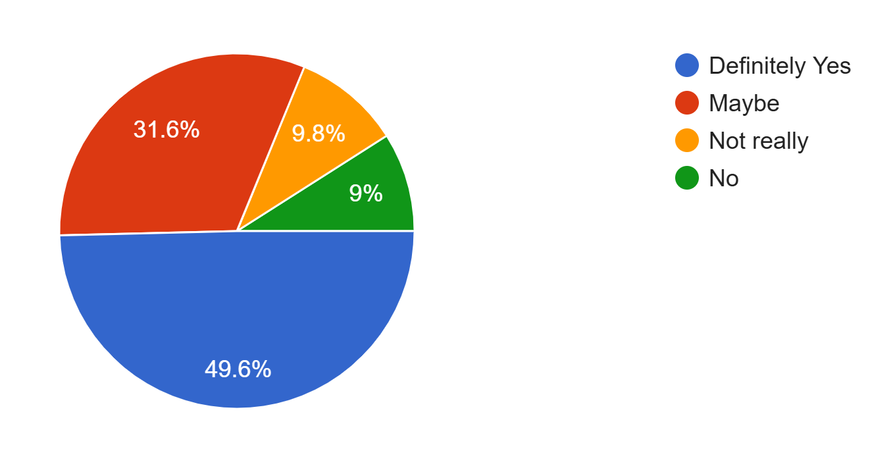
A Study on User Awareness and Data Protection Practices in Cloud Storage Services
.
Md. Sunzim Shahariar Shifat, Protikha Hira Tanwi, Tabassum Islam Zimia, Progga Banik, Albari Yasir Wahid
American International University – Bangladesh, Dhaka 1229, Bangladesh
Group No: 03 Supervised By: DR. JANNATUL FERDUS
Abstract
Result & Discussion
Table 2: Crosstabulation of Gender vs Updating Password
Cloud storage use has grown rapidly, but many users lack awareness of data protection mechanisms like encryption and privacy settings, exposing them to security risks. This study examines user awareness of data protection practices and how it varies based on experience, education, and trust in providers. The findings aim to support better data protection strategies and promote safer cloud adoption.
Gender | Every Month | Every 3 -6 Months | Once a year | Never
Male | 12.8% | 20.3% | 9% | 22.6%
Female | 1.5% | 13.5% | 12% | 8.3%
Fig. 1: Pie Chart of overall knowledge of CSS.
Males update passwords more often on a monthly basis (12.8% vs 1.5%) and every few months (20.3% vs 13.5%), but they also have the highest number who never update passwords at all (22.6% vs 8.3%). Females are more balanced in their habits with far fewer never updating (8.3%). This shows that males have mixed behaviors - some update regularly while many don't update at all - so they need better education about password security, though both genders need improvement overall.
From the survey, a total of 133 responses were collected where majority of the responders were student (92.5%). About 94% of them had basic to excellent overall knowledge on Cloud Storage Services and 91% knew about Data Encryption.
But in terms of security practices, only 29.3% of users turns on their multi factor authentication of their cloud storage account, only 14.3% changes the password regularly and 30% of the users backs up their data on another location.
Introduction
Cloud storage services are popular for backing up data, sharing files, and working together because they are easy to access and cost less. However, worries about privacy, security, and user knowledge make people unsure about trusting them. This study examines how much users know about data protection and how this affects their behavior, including understanding privacy policies, password habits, encryption knowledge, and trust in providers. The findings aim to show where companies and policymakers can improve user education and data protection.
Fig. 2: Pearson Chi-Square test.
Table 1: Chi-Square Analysis Table
Objectives
Comparison Category | Chi-Square Value (χ²) | p-value | Interpretation
Gender vs Updating Password | 12.672 | 0.005 | Ho is rejected. There is a significant association between gender and updating password of CSS.
Age vs Device Used to access Cloud Storage Services | 19.852 | 0.019 | Ho is rejected. There is a significant association between age and device they use to access Cloud Storages.
Occupation vs Suspicious Activity | 25.508 | 0.013 | Ho is rejected. There is a significant association between occupation and clicking on suspicious links
Income vs Data Breach Experience | 140.595 | 0.000 | There is highly significant association between income and data breach exp.
Age vs Version Used | 15.735 | 0.001 | Ho is rejected. There is a significant association between age vs which version of cloud storage they use
Income vs Version Used | 13.506 | 0.009 | There is a significant association between income vs which version of cloud storage they use
Income vs Usage Pattern | 152.026 | 0.000 | There is highly significant association between income and what type of data they store on the cloud.
Fig. 3: Pie Chart of responders interest in learning more.
To examine the level of knowledge and understanding users have regarding cloud storage services and their security risks.
Conclusion
To analyze the necessary steps taken byusers to keep their personal data safe indifferent cloud services.
User awareness of data protection in cloud storage is moderate but uneven. While people appreciate cloud convenience, many don't fully understand security risks or how to protect their data. Users often trust providers too much without managing their own security. Cloud companies should focus on better user education, clearer privacy policies, and easier security tools to improve protection and build trust. Bridging the gap between user awareness and actual security practices is crucial for safer and more confident cloud adoption.
To analyze and compare the data by doing Chi-Square Value test to find out their significance and relations with others.
Methodology
Survey Creation
Data Collection
The survey was shared with students and professionals from various industries.
Data Analysis
Collected data was analyzed using basic statistical methods such as frequencies, percentages, and Chi Square tes to identify awareness levels and data security practices.
A structured online survey was created in Google Forms with both multiple-choice focusing on cloud storage services and what the user knows about them.
References
M. A. Alzain, B. Soh, and E. Pardede, "A survey on data security issues in cloud storage: From single to multi-clouds," Journal of Software, vol. 7, no. 7, pp. 1514-1527, Jul. 2012.

